Slide 1
Open source, high performance, schema-free document-oriented database
www.mongodb.org

Slide 2
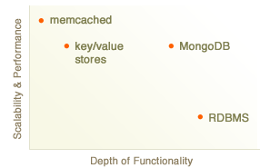
Goal : Blend performance and functionality

Slide 3
Performance Focus
Written in C++
Native client drivers
Simple atomicity only
Functionality
Dynamic queries
Query optimizer
Secondary indexes
Rich data types (Date, binary, files)
Sorting, cursors, field projection
Replication
Sharding
order preserving partitioning; elastic
alpha
Special features
Order preserving collections
Auto age-out collections
Insert or modify operation (good for real time counter collections)

Slide 4
Comparison
 | CouchDB | MongoDB
Implementation | Erlang | C++
Durable | Yes | No (repair step)
Atomic | Yes single object | Yes single object
Updates | MVCC | In place
Queries | Via materialized views | Dynamic
Interface | REST | Native driver
Replication? | Yes | Yes
Peer replication | Yes | No
Wide area replication | Yes | Yes
Scaling model | Replication (or -Lounge) | Sharding

Slide 5
Status
Core DB, Replication – production ready
Sharding – alpha
Try It!
www.mongodb.org
Get Involved
@mongodb
irc.freenode.net/#mongodb
Email dwight…10gen.com

